Slide 1
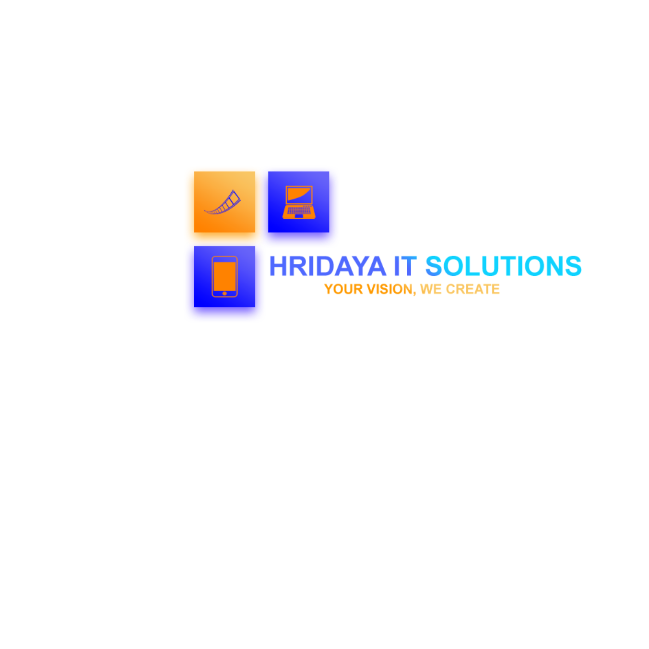
COMPANY PROFILE

Slide 2
ABOUT US
Founded with a passion for creativity and a vision for exceptional digital experiences, Hridaya IT Solutions has been at the forefront of providing innovative solutions in Website Design, Graphic Design, Digital Marketing, and the enchanting realm of Madhubani art. Established in [year], our journey began with a small team of talented individuals who shared a common goal: to revolutionize the way businesses connect with their audiences and celebrate the beauty of traditional art forms. Over the years, we have evolved into a leading provider of cutting-edge digital services, combining technical expertise with artistic excellence. Our commitment to staying at the forefront of industry trends and leveraging the latest technologies has allowed us to consistently deliver exceptional results. With a rich history of successful projects and satisfied clients, we continue to push boundaries, ignite creativity, and shape the digital landscape. At Hridaya IT Solutions, we are dedicated to transforming your vision into reality, creating captivating digital experiences that leave a lasting impact on your audience.

Slide 3
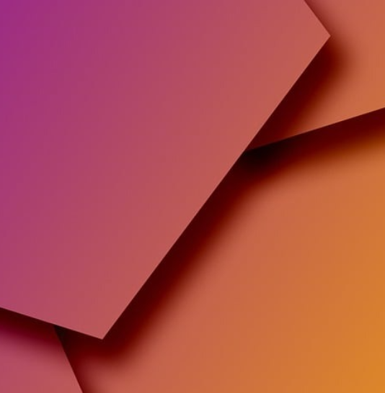
Our vision at Hridaya IT Solutions is to seamlessly blend the worlds of Website Design, Graphic Design, Digital Marketing, and Madhubani art, creating captivating digital experiences that empower businesses, foster connections, and inspire audiences. We aim to redefine creativity in the digital realm, pushing boundaries and delivering exceptional results that leave a lasting impact. Join us as we embark on a journey of innovation, artistic excellence, and transformative digital solutions.
OUR
VISION
Our mission at Hridaya IT Solutions is to combine Website Design, Graphic Design, Digital Marketing, and the beauty of Madhubani art to create transformative digital experiences. We aim to empower businesses with captivating designs, effective marketing strategies, and a touch of cultural heritage. Through our expertise and innovation, we strive to help our clients thrive in the digital world, leaving a lasting impression on their audiences. Join us on our mission to redefine creativity and unlock the true potential of your brand.
OUR
MISSION

Slide 4
WEBSITE DEVELOPMENT
GRAPHIC DESIGN
We specialize in crafting visually stunning and user-friendly websites that reflect your brand's identity. Our designs seamlessly blend aesthetics with functionality, ensuring an exceptional user experience.
Our team of talented designers brings your brand to life through striking logos, captivating illustrations, and thoughtfully designed materials. We create designs that effectively communicate your message.
OUR
SERVICES
DIGITAL MARKETING
MADHUBANI ART
We drive your online success through data-driven digital marketing strategies. From SEO and social media campaigns to content creation and email marketing,
Experience the enchanting world of Madhubani art infused into our designs, illustrations, and captivating artworks. Our talented artists bring vibrant colors and intricate detailing.

Slide 5
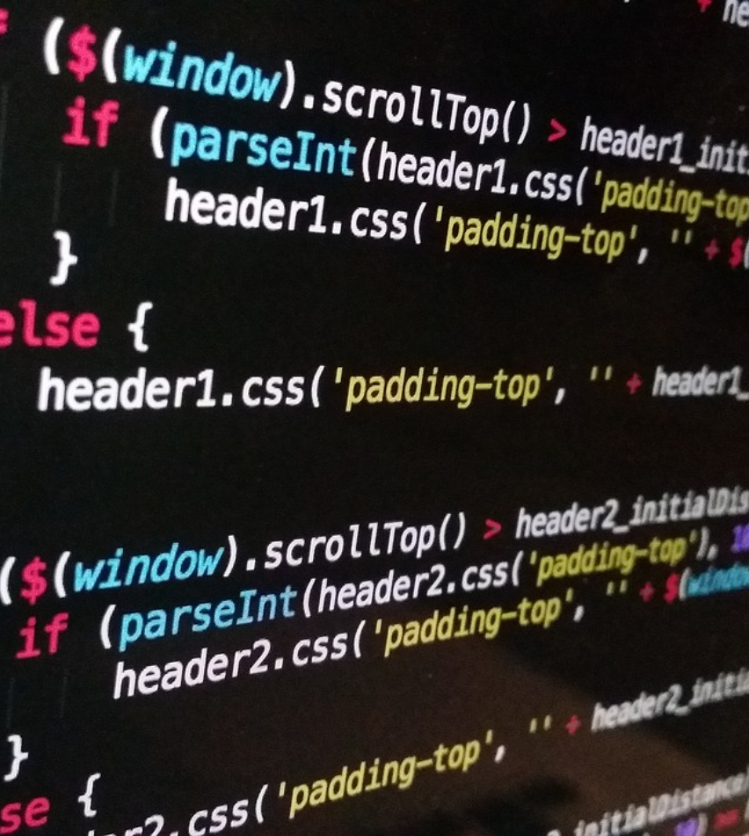
WEBSITE DEV
Website development involves the creation, design, and implementation of websites. It encompasses a range of activities, including coding, programming & content creation.
Custom Website Design and Development.
Responsive Web Design.
E-commerce Website Development.
Website Maintenance and Support.
Website Redesign and Revamp.
Web Hosting and Domain Registration.
Website Security and SSL Certificates.
Website Analytics and Reporting.

Slide 6
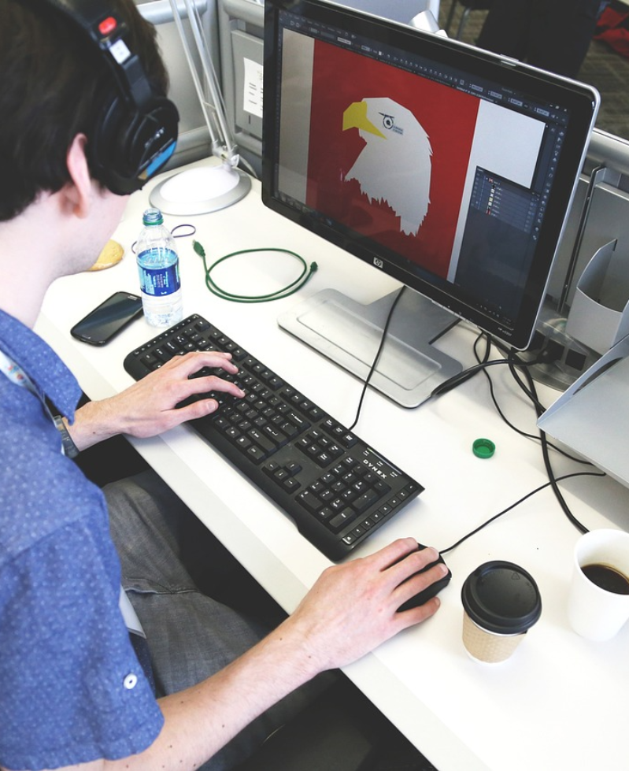
GRAPHIC DESIGN
Graphic design is the art and practice of visual communication. It involves creating visual content using various elements, such as typography, colors, illustrations, and images, to convey a specific message or evoke a desired response.
Logo Design
Brand Identity & Digital Design.
Business Cards Design
Video Invitation Design
Social Media Graphics
Packaging Design
Business Profile Design
Illustrations Design

Slide 7
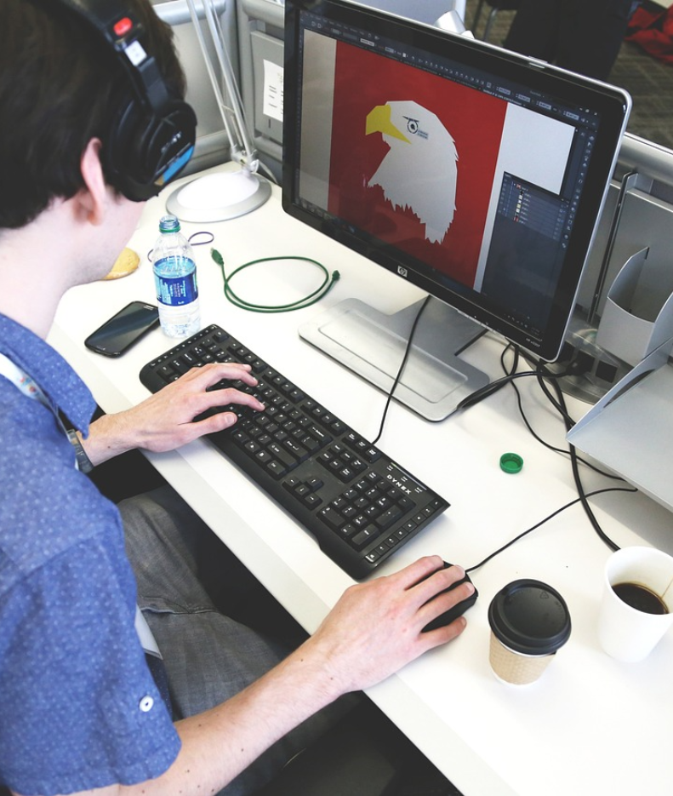
DIGITAL MKT.
Digital marketing refers to the practice of promoting products or services using digital channels and technologies. It encompasses various online marketing strategies and tactics to reach and engage with a target audience.
Search Engine Optimization (SEO).
Social Media Marketing.
Content Marketing.
Email Marketing.
Website Optimization.
Affiliate Marketing.
E-commerce Marketing.
Online Advertising (Display Ads, Remarketing).

Slide 8
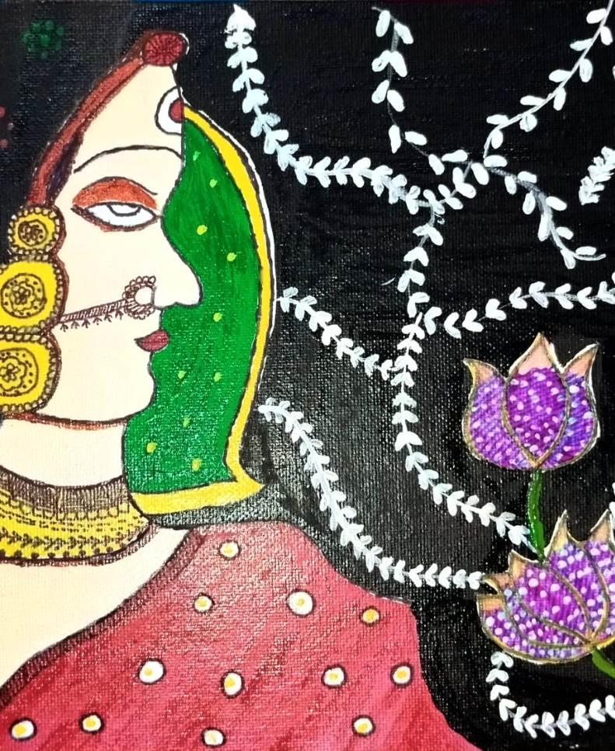
MADHUBANI ART
Madhubani art, also known as Mithila painting, is a traditional folk art form that originated in the Mithila region of Bihar, India. It is characterized by its vibrant colors, intricate patterns, and unique storytelling.
Madhubani Artwork Creation.
Custom Madhubani Paintings.
Madhubani Art Prints and Reproductions.
Madhubani Art Prints on Fabrics.
Madhubani Art Home Decor Products.
Madhubani Art Digital Downloads.
Madhubani Art Pillows, Cushion Covers.
Madhubani Art Posters.

Slide 9
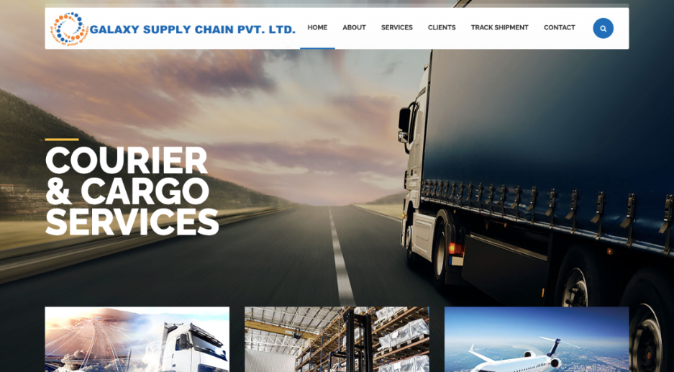
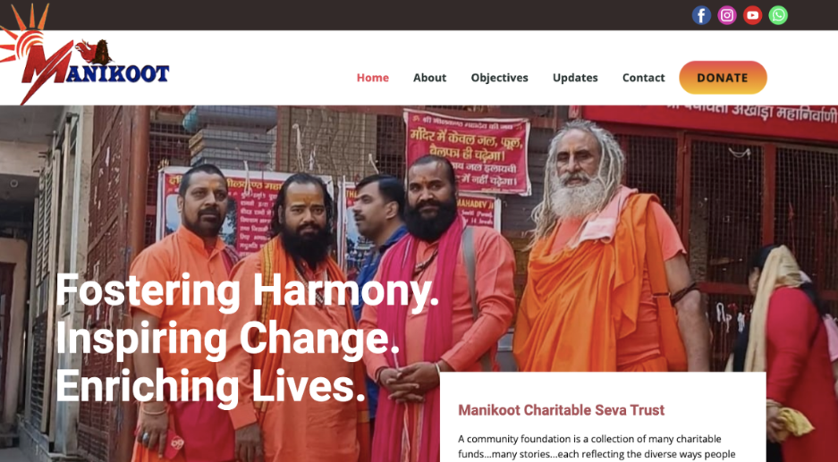
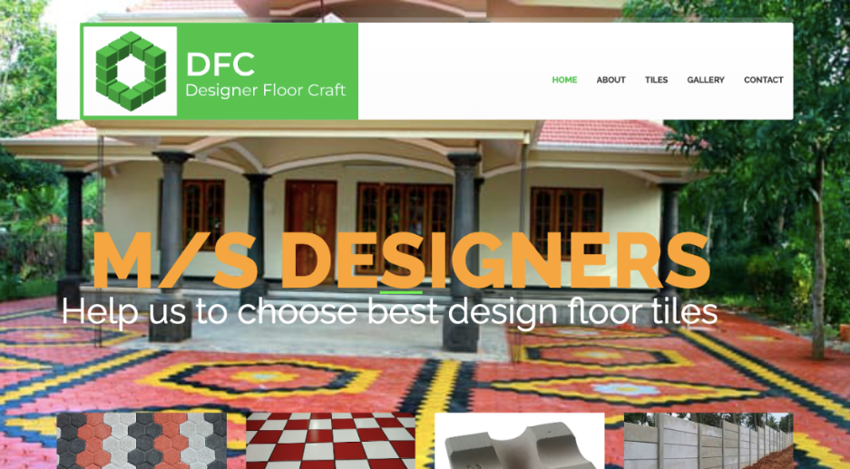
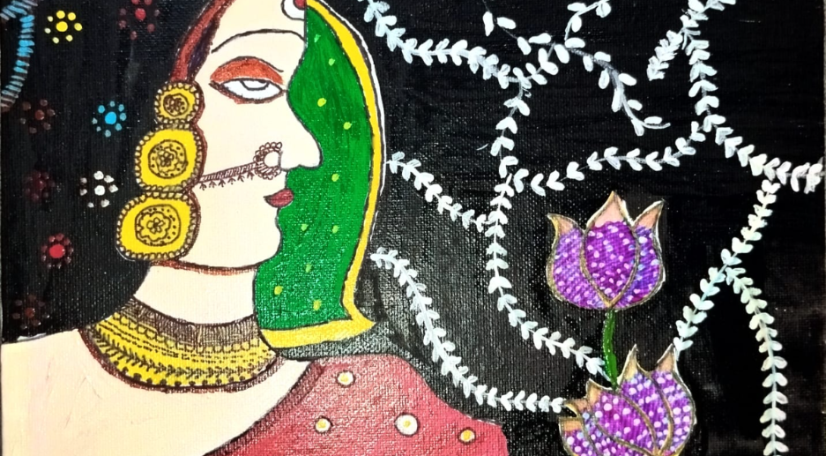
OUR
WORKS

Slide 10
TESTIMONIAL
PRASANNA P
PRADIP PARIYAR
DR. HARSHITA SHUKLA
The best in the market. you just leave everything on HITS for website creation, graphic design and all and he will give you the best going way beyond your expectation. I have contacted him for website creation of my company M/s Designer Floo craft and he goes beyond expectation in completing my work way before time and with the best design. I will highly recommend this company.
Thanks to Hridaya IT Solutions for video invitation service, our wedding had an extra touch of magic. The personalized and visually captivating invitation wowed our guests. Highly recommend their exceptional work!
Best Solution for Web Design, Graphic Designing related Work..
Literally delivered my project in very minimum time and
always available chats for minute
rectifications.

Slide 11
MAILING ADDRESS
PLOT NO. 183, KHEDI ENCALVE, NIT
FARIDABAD, HARYANA, 121004
THANK
YOU!
EMAIL ADDRESS
INFO@HRIDAYAIT.IN
PHONE NUMBER
+91 - 9582499245
+91 - 8700880258
WEBSITE
HTTP://WWW.HRIDAYAIT.IN

